Slide 1

Visualizing Data in Python

Slide 2

Objectives
In this session, you will learn to:
Implement Programming with multiple Tables.
Uses of Keys.
Implement Joins to Retrieve Data.
Visualize Data.
Build a Google Map from Geocoding.
Visualize Networks and Interconnections.
Visualize Mail Data.

Slide 3
Implement Programming with Multiple Tables
The basic requirements to be considered for programming in tables are
Use unique id while retrieving, updating and deleting the data from Tables.
Follow all the constraints rules while inserting and updating the data.
Notes:
It is always important to check the integrity of the data in our table. This can be achieved by using keys and Constraints.

Slide 4
Implement Programming with Multiple Tables (Contd.)
Constraints in Database Tables
Observations
“name” column in the “People” Table must be UNIQUE.
Combination of the two numbers in each row of the “Follows” Table must be Unique.
cur.execute('''INSERT OR IGNORE INTO People (name, retrieved)
VALUES ( ?, 0)''', ( friend, ) )
“OR IGNORE” clause should be added to the INSERT statement to indicate that the INSERT statement should the violation of rule “name must be unique”.
cur.execute('''CREATE TABLE IF NOT EXISTS People
(id INTEGER PRIMARY KEY, name TEXT UNIQUE, retrieved INTEGER)''')
cur.execute('''CREATE TABLE IF NOT EXISTS Follows
(from_id INTEGER, to_id INTEGER, UNIQUE(from_id, to_id))''')
Notes:
We can take advantage of these constraints in the following code:
cur.execute('''INSERT OR IGNORE INTO People (name, retrieved) VALUES ( ?, 0)''', ( friend, ) )
We add the OR IGNORE clause to our INSERT statement to indicate that if this particular INSERT would cause a violation of the “name must be unique” rule, the
database system is allowed to ignore the INSERT.
Similarly, the following code ensures that we don’t add the exact same Follows relationship twice.
cur.execute('''INSERT OR IGNORE INTO Follows (from_id, to_id) VALUES (?, ?)''', (id, friend_id) )
Again we simply tell the database to ignore our attempted INSERT if it would violate the uniqueness constraint that we specified for the Follows rows.

Slide 5
Implement Programming with Multiple Tables (Contd.)
Retrieve and/or insert a record
friend = u['screen_name']
cur.execute('SELECT id FROM People WHERE name = ? LIMIT 1',(friend, ) )
try:
friend_id = cur.fetchone()[0]
countold = countold + 1
except:
cur.execute('''INSERT OR IGNORE INTO People
(name, retrieved)VALUES ( ?, 0)''', ( friend, ) )
conn.commit()
if cur.rowcount != 1 :
print 'Error inserting account:',friend
continue
friend_id = cur.lastrowid
countnew = countnew + 1
except – Indicates the instruction to be carried out in case of an exception. In this case row was not found hence should be inserted.
INSERT OR IGNORE – Indicates errors to be avoided while inserting data.
cur.rowcount - Indicates how many rows are affected.
Notes:
If we end up in the except code, it simply means that the row was not found so we must insert the row. We use INSERT OR IGNORE just to avoid errors and then
call commit() to force the database to really be updated.
After the write is done, we can check the cur.rowcount to see how many rows were affected. Since we are attempting to insert a single row, if the number of affected rows is something other than one, it is an error.
If the INSERT is successful, we can look at cur.lastrowid to find out what value the database assigned to the id column in our newly created row.

Slide 6

Use Different Types of Keys
Logical Key - is a key that the “real world” might use to look up a row.
Primary Key - is usually a number that is assigned automatically by the database.
Foreign Key - is usually a number that points to the primary key of an associated row in a different table.
Notes:
A logical key is a key that the “real world” might use to look up a row. Since the logical key is how we look up a row from the outside world, it makes little sense to allow multiple rows with the same value in the table.
A primary key is usually a number that is assigned automatically by the database. It generally has no meaning outside the program and is only used to link rows from different tables together.
A foreign key is usually a number that points to the primary key of an associated row in a different table

Slide 7
Use JOIN to Retrieve Data
JOIN clause – used to combine data from different tables.
SELECT * FROM Follows JOIN People
ON Follows.from_id = People.id WHERE People.id = 1
JOIN clause indicates that the fields selected are from the Follows and People Tables.
The ON clause indicates how the two tables are to be joined.
Notes:
SQL uses the JOIN clause to re-connect these tables. In the JOIN clause you specify the fields that are used to re-connect the rows between the tables.
The following is an example of a SELECT with a JOIN clause:
SELECT * FROM Follows JOIN People ON Follows.from_id = People.id WHERE People.id = 1
The JOIN clause indicates that the fields we are selecting cross both the Follows and People tables. The ON clause indicates how the two tables are to be joined.
Take the rows from Follows and append the row from People where the field from_id in Follows is the same the id value in the People table.

Slide 8

Data Visualization
Data Visualization refers to the techniques used to communicate data or information by encoding it as visual objects.
(e.g., points, lines or bars)
Notes:
The beauty of an art lies in the message it conveys. At times, reality is not what we see or perceive. The endless efforts from the likes of Vinci and Picasso have tried to bring people closer to the reality using their exceptional artworks on a certain topic/matter.
Data scientists are no less than artists. They make paintings in form of digital visualization (of data) with a motive of manifesting the hidden patterns / insights in it. It is even more interesting to know that, the tendency of human perception, cognition and communication increases when he / she gets exposed to visualized form of any content/data.

Slide 9
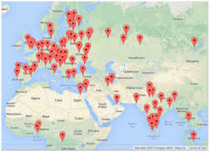
Google Geocoding
Geocoding is the process of converting addresses (like "1600 Amphitheatre Parkway, Mountain View, CA") into geographic coordinates (like latitude 37.423021 and longitude -122.083739), which can be used to place markers on a map, or position the map.
Notes:
Data Visualization takes the sample data from the repository that program will download, parse the sample data from columns and rows to a list of dictionaries, then render that data in two different graphs and in Google Maps.
Let’s discuss about a project where the Google geocoding API will clean up some user entered geographic locations of university names and then placing the data on a
Google map.
In this project we have 5 files – geoload.py, geodump.py, where.data, where.js and where.html.
where.data – This file contains a few hundred data items like geographic locations of university names.
geoload.py program - This program will read the input lines in where.data and for each line check to see if it is already in the database and if data is not present for the location, call the geocoding API to retrieve the data and store it in the database.
geodump.py program - This program reads the database and writes the file where.js with the location, latitude, and longitude in the form of executable JavaScript code.
where.js – This file is used to get the data to be visualized with the most recent data.
where.html – This file consists of HTML and JavaScript to visualize a Google map.

Slide 10
Google Geocoding (Contd.)
To start using Geocoding API, Create or Select a Project in the Google Developers Console and enable the API.
https://console.developers.google.com/flows/enableapi?apiid=geocoding_backend&keyType=SERVER_SIDE
Notes:
Use the following URL and enter credential of google account to get the developer console:
https://console.developers.google.com/flows/enableapi?apiid=geocoding_backend&keyType=SERVER_SIDE

Slide 11
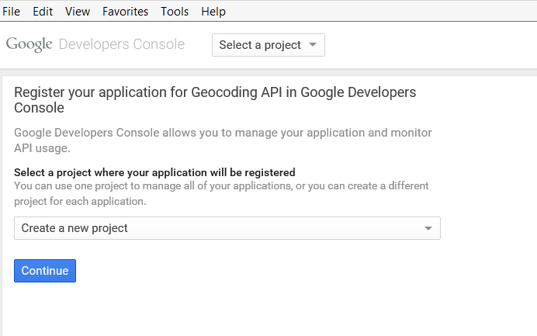
Google Developers Console
Notes:
Agree with term and condition before registering the application for Geocoding API in Google Developer Console.

Slide 12
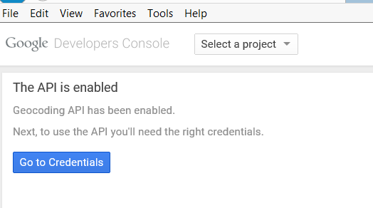
Google Developers Console
Notes:
Once the project will be created the Geocoding API will be enabled. Also all the status related activities can be visualized on Project Dashboard.
This is the interface where developer can deploy any Geocoding program and can perform the following operations:
Monitoring Traces, Logs and Dashboard.
Browse and debug the source code.
Modify the network settings of project.

Slide 13
Visualizing Networks and Interconnections
What is Visualizing networks and interconnections?

Slide 14
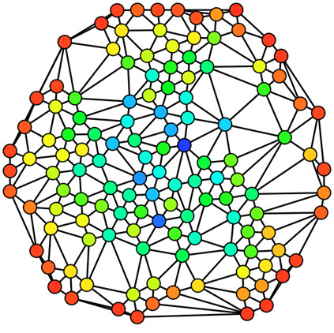
Visualizing Networks and Interconnections (Contd.)
The first program (spider.py) program crawls a web site and pulls a series of pages into the database (spider.sqlite), recording the links between pages. You can restart the process at any time by removing the spider.sqlite file and re-running spider.py.
Notes:
Let’s discuss another project about Visualizing networks and interconnections using some of the functions of a search engine.
In this project we have 8 files –
spider.py - crawls a web site and pulls a series of pages into the database (spider.sqlite), recording the links between pages.
spdump.py - to dump the contents of the spider.sqlite file.
sprank.py – to get page rank on the pages. it will simply refine the page rank each time run it.
spreset.py - to restart the page rank calculations without re-spidering the web pages.
prank.py – to the page rank values converge.
spjson.py - to read the database and write the data for the most highly linked pages in JSON format to be viewed in a web browser.
force.html - this shows an automatic layout of the nodes and links. User can click and drag any node and he/she can also double click on a node to find the URL that is represented by the node.
spider.json - refresh in the browser to get the new data.

Slide 15
Visualizing Mail Data
Sometimes you have to pull down mail data from servers and that might take quite some time and the data might be inconsistent, error filled and need a lot of clean up or adjustment.
We work with an application that is the most complex and pull down nearly a gigabyte of data and visualize it.
Notes:
Let’s discuss another project about Visualizing mail data from servers and data is most complex so far and pull down nearly a gigabyte of data and visualize it.
In this project we have 7 files –
gmane.py - operates as a responsible caching spider in that it runs slowly and retrieves one mail message per second so as to avoid getting throttled by gmane. It stores all of its data in a database and can be interrupted and re-started as often as needed. It may take many hours to pull all the data down. So User may need to restart several times.
gmodel.py - reads the rough/raw data from content.sqlite and produces a cleaned-up and well-modeled version of the data in the file index.sqlite. The file index.sqlite will be much smaller (often 10X smaller) than content.sqlite because it also compresses the header and body text.
gbasic.py - simplest data analysis is to determine ”who sent the most mail?” and ”which organization sent the most mail”?
gword.py - produces a simple visualization of the word frequency in the subject lines.
gline.py - computes e-mail participation by organizations over time.
The output of this project output is written to gline.js which is visualized using gline.htm.

Slide 16

Just a Minute
__________Key is used to uniquely identify records in a table.

Slide 17
Just a Minute
__________Key is used to uniquely identify records in a table.
Answer:
Primary

Slide 18
Activity
Activity : Programming With Multiple Tables
Problem Statement:
Write a simple program to retrieve data from multiple tables.
Prerequisite: For this activity please refer school.db available in “Data_File_For_Students” folder.
Notes:
Solution:
Prerequisite: For this activity you need to use school.db which is available with Data_File_For_Students.
In order to do this activity, you need to perform the following tasks:
Create a Python empty project.
Use sqlite3 library to access python database API.
Use connect() to create and open the connection.
Use execute() to write SQL select statement to join two table.
Use close() to close the connection
Task 1: Create a Python empty project:
Step 1: Open NetBeans 8.0.2.
Step 2: Click File menu.
Step 3: Select New Project.
Step 4: Select Python from Categories list and Python Project from Projects list.
Step 5: Click Next button.
Step 6: On New Python Project dialog box set the Project Name as CR_Session17_Activity01.
Step 7: Select project Location by clicking Browse button.
Step 8: Click Finish button.
Task 2: Use sqlite3 library to access python database API, use connect() to create and open the connection, use execute() to execute SQL select statement to join two tables, use close() to close the connection:
Step 1: Type the following code:
import sqlite3
conn = sqlite3.connect('school.db')
cur = conn.cursor()
cur.execute('SELECT * FROM teacher')
count = 0
print 'Teacher:'
for row in cur :
if count < 5:
print("{0} {1}".format(row[0],row[1]))
count = count + 1
print count, 'rows.'
cur.execute('SELECT * FROM course')
count = 0
print 'Course:'
for row in cur :
if count < 5:
print("{0} {1} {2}".format(row[0],row[1],row[2]))
count = count + 1
print count, 'rows.'
cur.execute('''SELECT * FROM teacher JOIN course
ON teacher.id = course.teacherid''')
count = 0
print("TeacherId TeacherName CourseId CourseName TeacherId")
for row in cur :
if count < 5:
print("{0} {1} {2} {3} {4}".format(row[0],row[1],row[2],row[3],row[4]))
count = count + 1
print count, 'rows.'
cur.close()
Step 2: Run the program.

Slide 19
Summary
In this session , you have learned that :
Data Visualization refers to the techniques used to communicate data.
Geocoding is the process of converting addresses.
Geocoding API is used for Visualizing Networks and Interconnections.

